Slide 1


2401FT_DS | Python Week 3
8 April - 10 May
Marc, Ereshia & Oludare

Slide 2
01.
Announcements
02.
Python Packages
03.
Python Environments
04.
Numpy and Pandas - Demo
05.
Integrated Project 1: Tips

Slide 3
Announcements
Things to remember…
Assessments due this week:
26 April 23:59pm CAT: Integrated Project: Understanding Maji Ndogo's agriculture [Code Challenge]
Week 4 of Python (29 April - 3 May) more python content and two MCQ assessments.
Week 5 of Python (6 May - 10 May)
Python Exam Monday 6 May from 8am - 5pm CAT (Timed Exam)
Group Project: (Groups of 5)
Tuesday 7 May: Project Kick-off and explanation
Friday 10 May: Presentations

Slide 4
01.
Announcements
02.
Python Packages
03.
Python Environments
04.
Numpy and Pandas - Demo
05.
Integrated Project 1: Tips

Slide 5
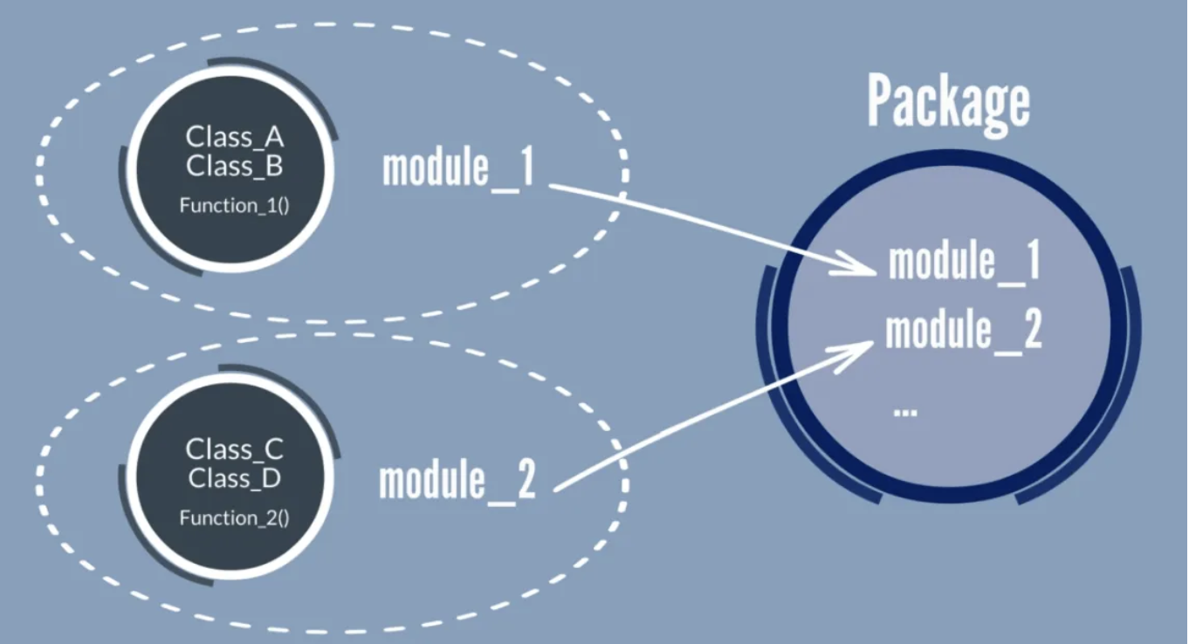
Python Packages
What is a python package?
Packages in Python are similar to directories or folders.
Sub-packages and modules
Python has a hierarchical directory structure
A directory in python (package) must contain a file named __init__.py

Slide 6
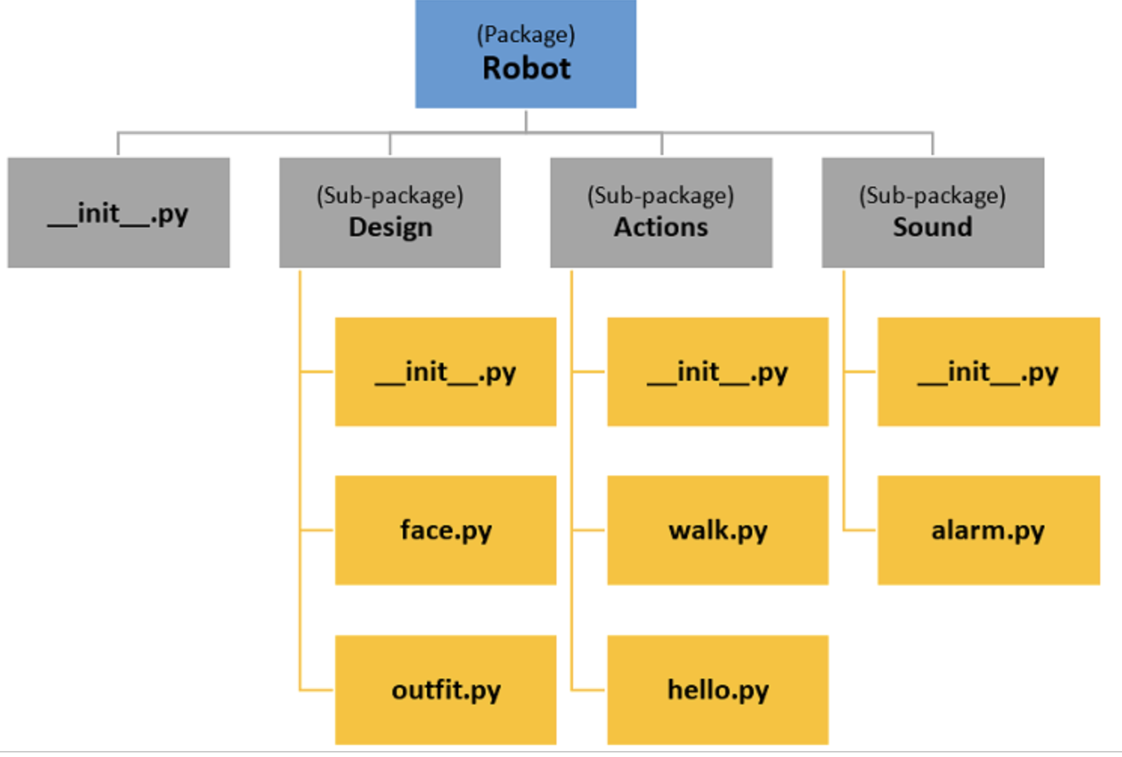
Python Packages
What is a python package?

Slide 7
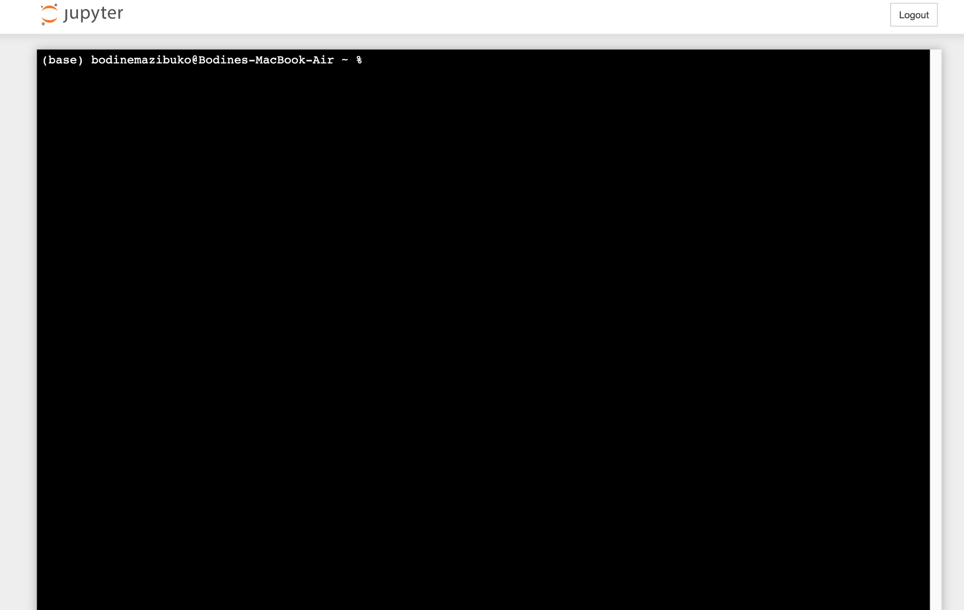
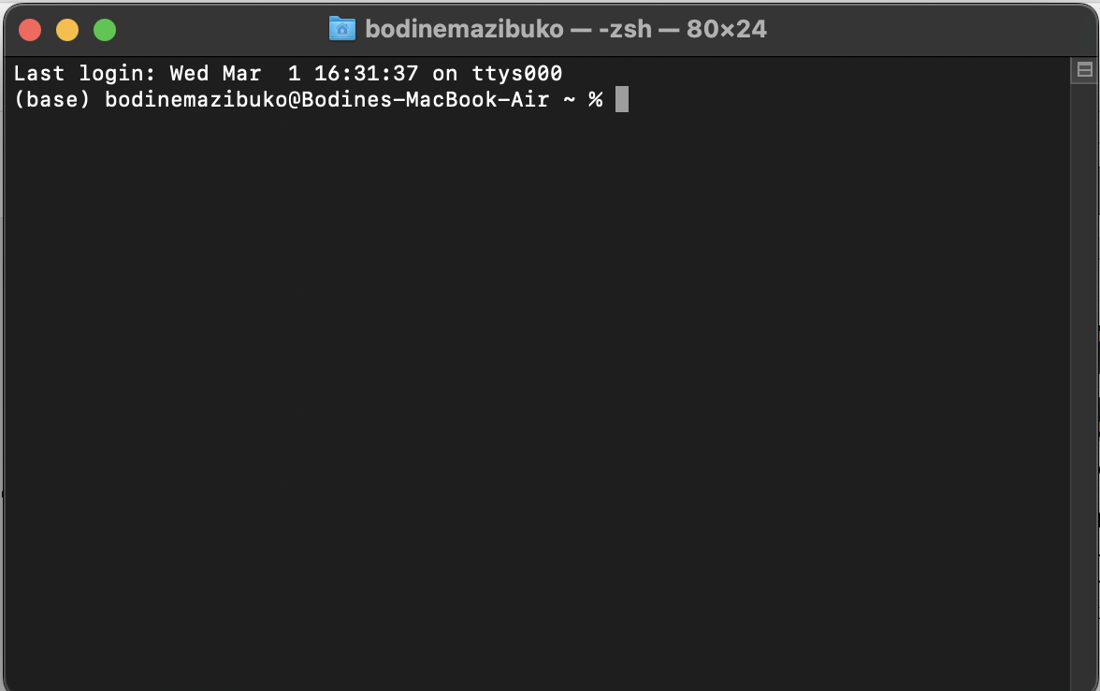

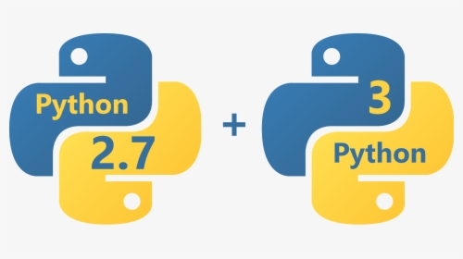
Python Packages
Installing python packages
Open a terminal or command prompt
Type the following command to install your package
conda install <package-name>
pip install <package-name>/ pip3 install <package-name>

Slide 8
Python Packages
Quick short hands
To get a list of all the python packages currently installed in your python environment
conda list
pip3 freeze / pip freeze
To check for the particular version of the the python package you have installed
conda list <package-name>
pip show <package-name> / pip3 show <package-name>
To update a package
conda update <package-name>
pip install --upgrade <package-name>
pip3 install --upgrade <package-name>
To update all the packages you have installed in your environment
conda update --all
pip freeze | xargs pip install -U
pip3 freeze | xargs pip install -U

Slide 9
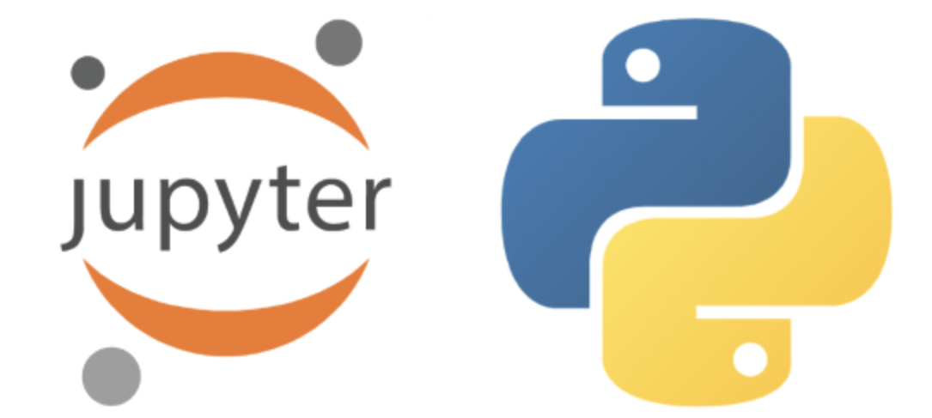
Python Packages
How to access packages and modules in a python program?
- To access the module 'hello', simply call:
import Robot.Actions.hello
Another way to access module 'hello' is:
from Robot.Actions import hello
To access all the module and sub-packages from a package:
from Robot import *

Slide 10
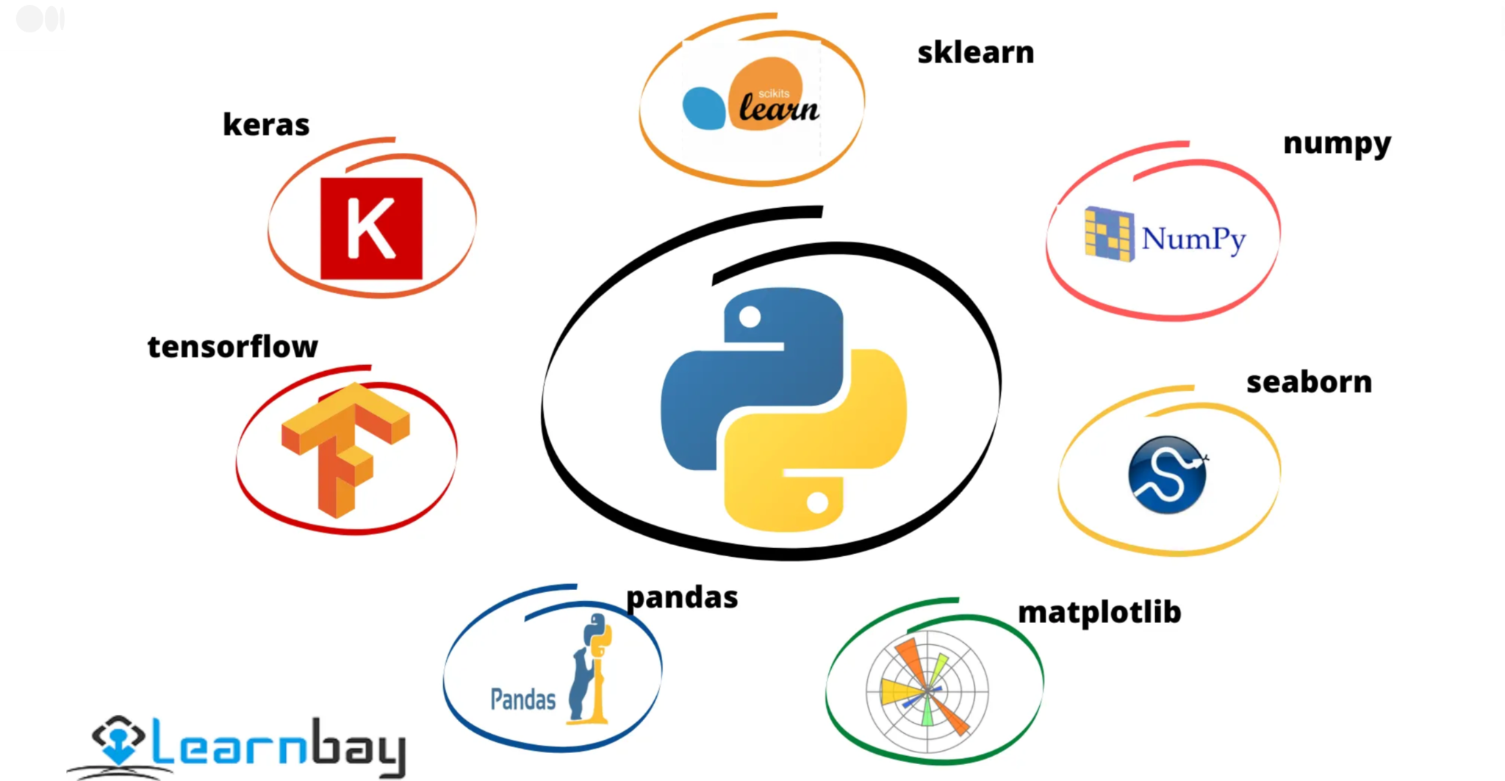
Python Packages
Popular python packages

Slide 11
01.
Announcements
02.
Python Packages
03.
Python Environments
04.
Numpy and Pandas - Demo
05.
Integrated Project 1: Tips

Slide 12
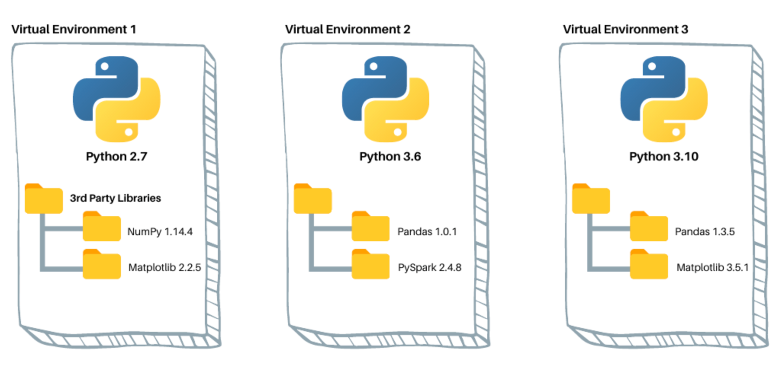
Python Environments
What is a python environment?
Self-contained directory or folder
It is an isolated space where you can install and manage different versions of Python and their associated packages

Slide 13
Python Environments
Creating and Activating a Python environment.
To create a Python environment, you can use a package manager such as conda or virtualenv
Open a terminal or command prompt.
Type the following command and replace env_name with your desired environment name
Press Enter and follow the prompts to confirm the installation.
conda create --name env_name
virtualenv env_name
To activate a Python environment
Once the installation is complete, activate the environment by typing:
conda activate env_name
Now you can install specific Python packages within your new environment.

Slide 14
01.
Announcements
02.
Python Packages
03.
Python Environments
04.
Numpy and Pandas - Demo
05.
Integrated Project 1: Tips

Slide 15
01.
Announcements
02.
Python Packages
03.
Python Environments
04.
Numpy and Pandas - Demo
05.
Integrated Project 1: Tips

Slide 16
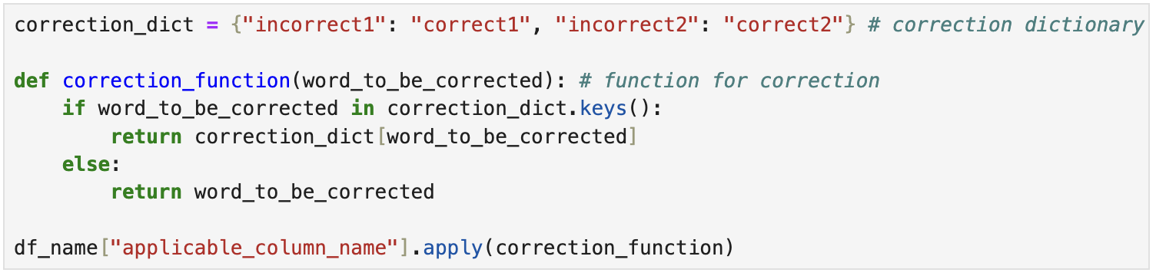
Integrated Project 1
Tips
1. Data Manipulation and Cleaning:
Renaming Columns:
Correcting Data Entries

Slide 17
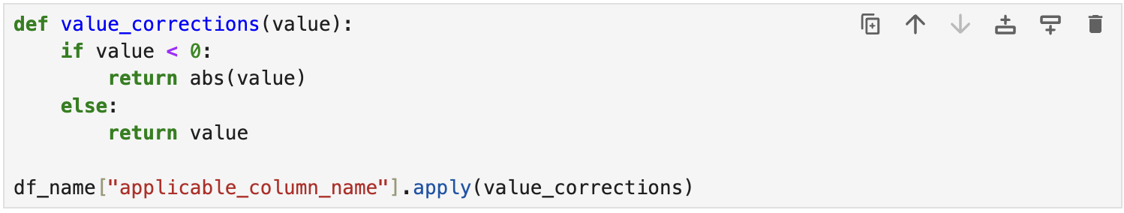
Integrated Project 1
Tips - Continued
2. Data Transformation:
Handling Negative Values

Slide 18
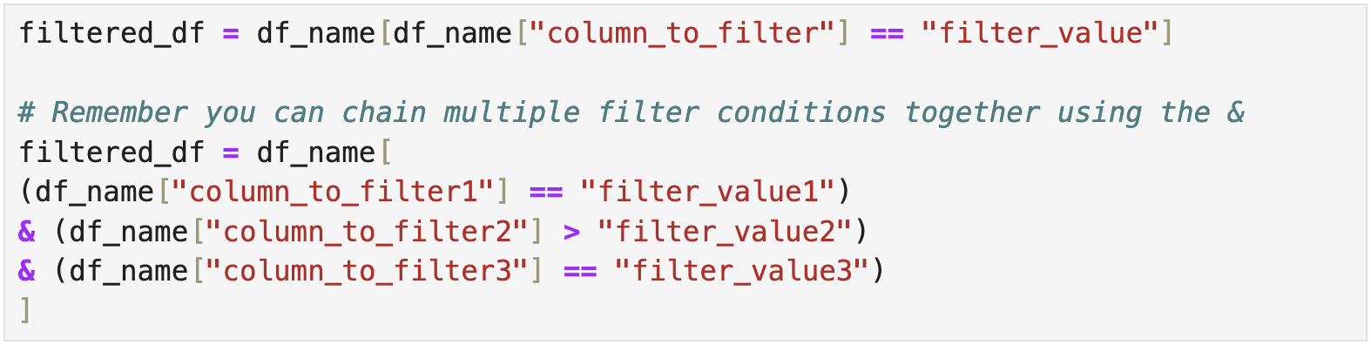
Integrated Project 1
Tips - Continued
3. Data Analysis:
Groupby Operations
Conditional Filtering:

Slide 19
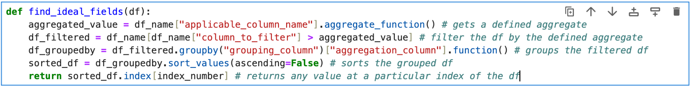
Integrated Project 1
Tips - Continued
4. Custom Functions with Pandas:
Custom Functions for Data Analysis:

Slide 20
Integrated Project 1
Tips - Continued
5. Others:
We would be using some knowledge from SQL:
Ensure you run the notebook from the extracted student pack directory
We will connect to our serverless database using SQLAlchemy. The relevant codes are provided in the notebook
You will need to use your knowledge of how to join tables using `JOIN` and `ON` keywords.
You will need to write your JOIN query using the python multi-line string format as a variable. Just go to the next line and write your normal SQL query to join all relevant table using the JOIN key.
Remember you can have multiple submissions. Do not wait to the last minute to begin the project

Slide 21
Thank you

